Slide 2
EEG Signal Processing BCI: SSVEP
Group 31• 27.04.18
Prashanth H C
Pavan Kumar D
Sawan Singh Mahara
Lakshmiraj
Mrs. Vidya T V
Assistant Professor, PESIT-BSC

Slide 3
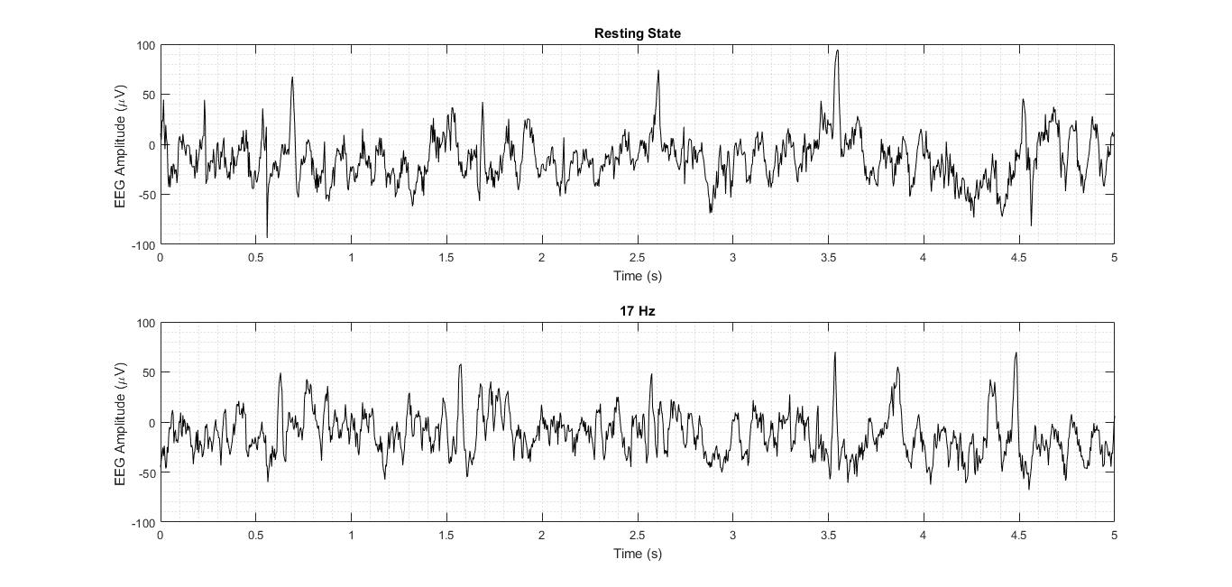

Slide 4
A

Slide 5
A
B

Slide 6
Thank You

